Slide 1
SAS Collaborations Lessons for Reflectometry?
Andrew Jackson
ESS

Slide 2
SAS Data Analysis - SasView

Slide 3
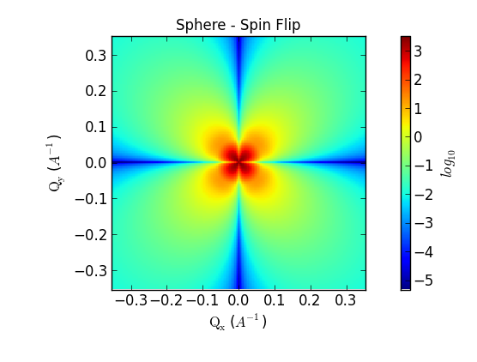
SasView – Small Angle Scattering Analysis software
www.sasview.org
User friendly, open source analytical modeling of SAS data.
INCLUDES:
Large number of 1D scattering models
2D analysis for oriented objects
Batch mode
Magnetic contrast with PA
Lots of extra tools
Much more to come
COLLABORATIVE COMMUNITY DEVELOPMENT MODEL
6 active facilities: ORNL, ISIS, NIST, ESS, ILL
1st code camp at NIST April 1 2013
2nd code camp held at ISIS April 1 2014
3rd code camp in Denmark hosted by ESS Feb 11 - 20 2015
New facilities contributing: Diamond and ANSTO
Growing interest/New Developers welcome

Slide 4


SasView – Where did it come from?
www.sasview.org
DANSE project output
~ 8.5% of funds were for SANS
Kickoff meeting August 2006
Heritage: NIST IGOR macros

Slide 5
Analysis Software: Who’s job is it anyway?
Analysis is where the science is → the USER’S JOB
Scattering is a tool and part of providing the tool should be analysis tools → the FACILITY’S JOB
Data on disk is useless to EVERYBODY

Slide 6
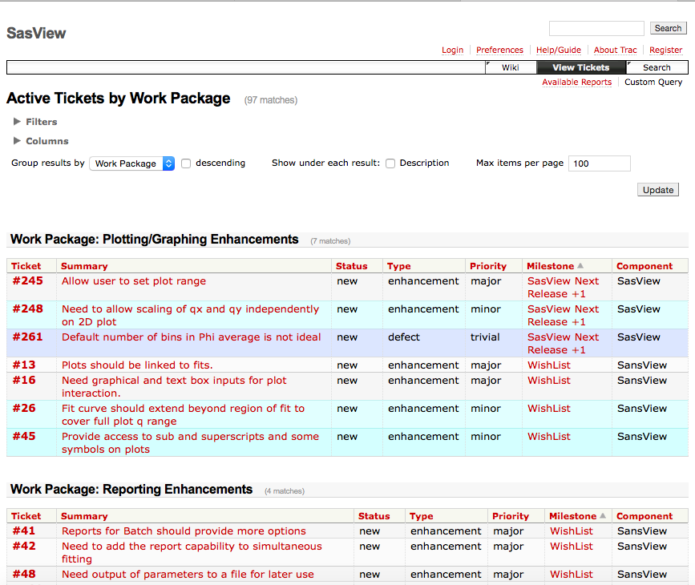
SasView – How is it managed?
www.sasview.org
Task and bug tracking – sasview.org/trac
users@ and help@ mailing lists
Developer group with mailing list and
bi-weekly video/audio conference via web
Management team with mailing list and meetings as needed – approximately quarterly.
Paul Butler (NIST)
Andrew Jackson (ESS)
Mathieu Doucet (ORNL)
Steve King (ISIS)

Slide 7
Vision : Community Software
Can we leverage communities as contributors as well as consumers?
Build a “user” community
Usability
Low barrier for entry
Lowering barrier to first fit
Ease of use
Good documentation
On line tutorials
Dissemination
Tutorial workshops at various levels
Awareness through talks and papers
Build a community driven/supported sustainable analysis software project by partnering facilities, power users, and users
Ease the barrier to contribution while maintaining code integrity
Decision making on core philosophy and major restructuring
Responsibility!!!!! Who ensures help gets answered? Who ensures bugs get addressed? Who ensures restructuring to prevent obsolescence (languages/packages move on)
Compete for (targeted finite timeframe) funding to continue to add/build new cutting edge tools.

Slide 8
SAS Collaboration - canSAS

Slide 9
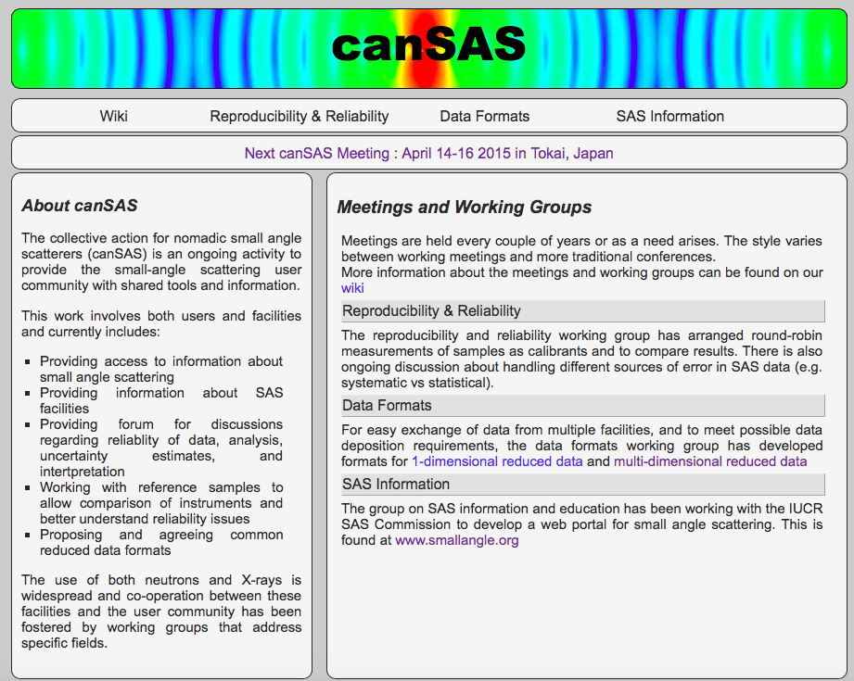
canSAS : What is it?
www.cansas.org
Reproducibility and Reliability
Standard samples
Round robin measurements
Description of uncertainties
Data Formats
Common formats for data interchange with adequate metadata capability
Enabler of reproducibility and reliability work
SAS Information

Slide 10
canSAS : Meetings
www.cansas.org
Meetings “as needed” – canSAS VIII April this year hosted by JPARC/CROSS
Act as a catalyst for collaborations within SAS community
Wiki for “working groups”

Slide 11
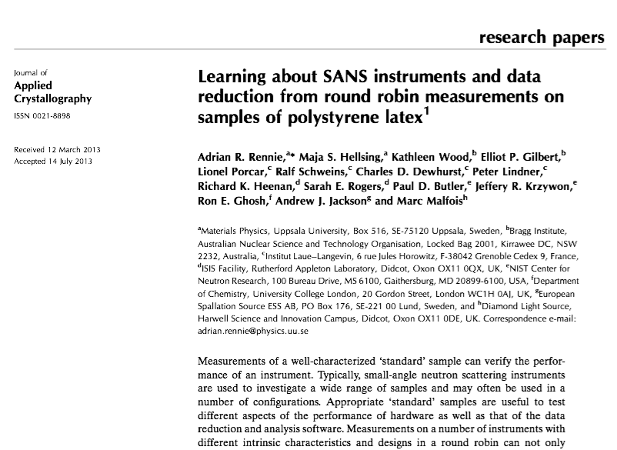
canSAS : Outcomes
www.cansas.org
Paper on round robin measurements of standard latex sample
Calibration standard (J. Ilavsky & A. Allen)
1D data format for reduced data
Output by Mantid and NIST/ANSTO Igor
Read by SasView
Routines to read created for
Python
Igor
Fortran
Java
nD data format for reduced data with support for complex combinations of axes and well described uncertainties
Implementation agnostic
Adopted by NeXUS December 2014 with implementation in HDF5

Slide 12
Lessons for Reflectometry?
Get people round the table – Today!
Focus on areas of agreement and start working together
Don’t let the perfect be the enemy of good
It is all about the people
Success breeds success
Sell, sell, sell! The work is for nothing if you don’t get people using it.
Manage the transition / interface between “research project” and “reliable product”

